Slide 1
My Project BATIM’ELLES

Slide 2
Powerful Business Women Infographics
Here is where this template begins

Slide 3
Powerful Business Women Infographics
Glass Ceiling
Mercury is the closest planet to the Sun and the smallest one

Slide 4
Powerful Business Women Infographics
1
2
3
4
Venus
Jupiter
Mercury
Mars
It has a beautiful name and is the second planet from the Sun
Jupiter is a gas giant and the biggest planet in the Solar System
Mercury is the closest planet to the Sun and the smallest one
Despite being red, Mars is actually a cold place full of iron oxide dust

Slide 5


Powerful Business Women Infographics
Gender Pay Gap
7k
5.8k
4k
3.2k
3k
2.1k
Farmer
Police
Doctor
Farmer
Police
Doctor
Follow the link in the graph to modify its data and then paste the new one here. For more info, click here

Slide 6
Powerful Business Women Infographics
Mercury is the closest planet to the Sun and the smallest one
Venus has a beautiful name and is the second planet from the Sun
English
Spanish
Jupiter is a gas giant and the biggest planet in the Solar System
Despite being red, Mars is actually a cold place full of iron oxide dust
French
Japanese

Slide 7
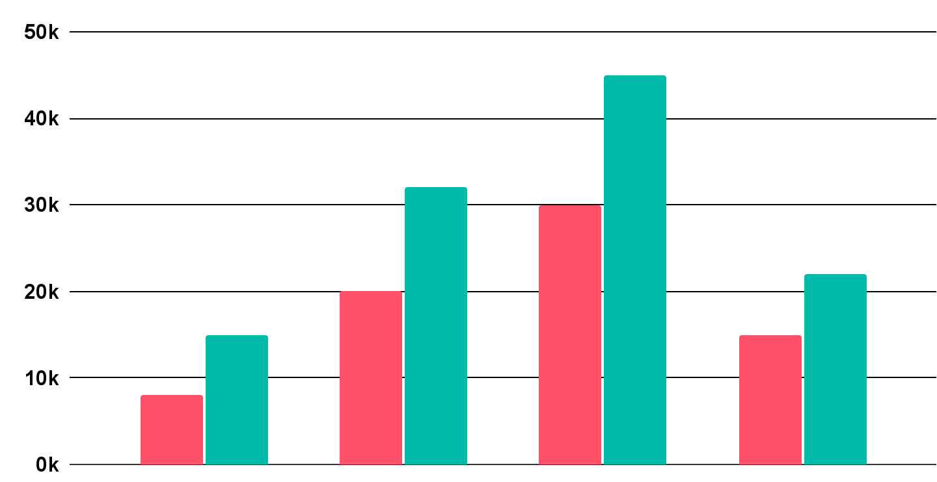
Powerful Business Women Infographics
Gender Pay Gap
Women
Men
Venus is terribly hot, even hotter than Mercury
Physician
Nurse
Consultant
Teacher
Follow the link in the graph to modify its data and then paste the new one here. For more info, click here

Slide 8
Powerful Business Women Infographics
Mercury
Venus
Mercury is the closest planet to the Sun and the smallest one
Venus has a beautiful name and is the second planet from the Sun
Jupiter
Mars
Jupiter is a gas giant and the biggest planet in the Solar System
Despite being red, Mars is actually a cold place full of iron oxide dust

Slide 9
Powerful Business Women Infographics
Good Qualifications | Patience | Teamwork | Public Speaking
Mercury is the smallest planet in the Solar System | Saturn is a gas giant and has several rings | Jupiter is the biggest planet in the Solar System | Despite being red, Mars is actually a cold place

Slide 10
Powerful Business Women Infographics
1
Problem Solving
Venus has a beautiful name and is the second planet from the Sun
2
Leadership
Mercury is the closest planet to the Sun and the smallest one
3
Organisation
Despite being red, Mars is actually a cold place
4
Perseverance & Motivation
Jupiter is the biggest planet in the entire Solar System

Slide 11
Powerful Business Women Infographics
Venus
Mars
Venus is terribly hot, even hotter than Mercury
Despite being red, Mars is actually a cold place

Slide 12
Powerful Business Women Infographics
Jupiter
Jupiter is the biggest planet in the Solar System
Mercury
Venus
Mercury is the smallest planet in the Solar System
Venus is terribly hot, even hotter than Mercury
Saturn
Mars
Saturn is a gas giant and has several rings
Despite being red, Mars is actually a cold place

Slide 13

Powerful Business Women Infographics
15%
Perseverance
Venus has a beautiful name and is the second planet from the Sun
10%
Confidence
Despite being red, Mars is actually a cold place full of iron oxide dust
10%
Optimism
Mercury is the closest planet to the Sun and the smallest one
65%
Hard Work
Follow the link in the graph to modify its data and then paste the new one here. For more info, click here
Jupiter is a gas giant and the biggest planet in the Solar System

Slide 14
Powerful Business Women Infographics
Percentage Difference between Women and Men Earnings
10-15%
15-20%
20-25%
25-30%
30% +
Jupiter is the biggest planet of them all
Saturn is a gas giant and has several rings
Earth is the planet where we all live on
Venus is the second planet from the Sun
Neptune is far away from Earth

Slide 15
Powerful Business Women Infographics
Progress at work
Year 1
Year 5
Year 10
Year 20
Staff
Manager
CEO
Board of Directors
Mars is actually a cold place
Neptune is far away from us
Jupiter is a really big planet
Mercury is a really small planet
Mercury is the closest planet to the Sun
Neptune is far away from Earth
Jupiter is a gas giant and a really big planet
Venus has a beautiful name

Slide 16
Powerful Business Women Infographics
Glass Ceiling
Venus
Venus is terribly hot, even hotter than Mercury
Jupier
Jupiter is the biggt planet in the Solar System

Slide 17
Powerful Business Women Infographics
1
2
3
4
5
Mercury
Saturn
Venus
Earth
Mars
It’s the closest planet to the Sun and the smallest one in the Solar System
It’s a gas giant and has several rings. It's composed mostly of hydrogen and helium
Venus has a beautiful name and is the second planet from the Sun
Earth is the third planet from the Sun and the only one that harbors life
Despite being red, Mars is actually a cold place full of iron oxide dust

Slide 18
Powerful Business Women Infographics
Venus
Venus is the second planet from the Sun
Mercury
Mars
It’s the closest planet to the Sun and a small planet
Despite being red, Mars is actually a cold place

Slide 19
Powerful Business Women Infographics
How Business Women have been successful
Studying Hard
Getting a Degree
Overcoming Obstacles
Reaching Success
Saturn is a gas giant and has several rings
Mercury is the smallest planet in the Solar System
Neptune is the farthest planet from the Sun
Despite being red, Mars is actually a cold place

Slide 20
Powerful Business Women Infographics
How Successful Women invest their free time
Painting
Sewing
Mercury is the closest planet to the Sun and the smallest one
Saturn is a gas giant and is composed mostly of hydrogen and helium
Reading
Resting
Jupiter is a gas giant and the biggest planet in the Solar System
Venus has a beautiful name and is the second planet from the Sun

Slide 21
Powerful Business Women Infographics
Mercury
Venus
Mercury is the smallest planet in the Solar System
Venus is terribly hot, even hotter than Mercury
Saturn
Mars
Saturn is a gas giant and has several rings
Despite being red, Mars is actually a cold place
Jupiter
Earth
Jupiter is the biggest planet in the Solar System
Earth is the third planet and is where we all live on

Slide 22

Powerful Business Women Infographics
Achieving success at work VS managing private life
65%
35%
Career Work
Personal life
Mercury is the closest planet to the Sun
Despite being red, Mars is actually a cold place
Follow the link in the graph to modify its data and then paste the new one here. For more info, click here

Slide 23
Powerful Business Women Infographics
Mars
Venus
Despite being red, Mars is actually a cold place full of iron oxide dust
Venus has a beautiful name and is the second planet from the Sun
Jupiter
Mercury
Jupiter is a gas giant and the biggest planet in the Solar System
Mercury is the closest planet to the Sun and the smallest one

Slide 24
Powerful Business Women Infographics
Breaking Glass Ceiling
1
3
2
1
2
Mercury
Mars
Mercury is the closest planet to the Sun and the smallest one
4
Despite being red, Mars is actually a cold place full of iron oxide dust
3
4
Jupiter
Venus
Jupiter is a gas giant and the biggest planet in the Solar System
Venus has a beautiful name and is the second planet from the Sun

Slide 25
Powerful Business Women Infographics
Jupiter
Venus
Mercury
It’s the biggest planet in the Solar System
Venus is terribly hot, even hotter than Mercury
It’s the smallest planet in the Solar System
Saturn
Earth
Mars
Saturn is a gas giant and has several rings
Earth is the third planet from the Sun. It has life on it
Despite being red, Mars is actually a cold place

Slide 26
Powerful Business Women Infographics
The 4 fastest growing sectors for women-owned businesses
Entertainment
Education
Mercury is the smallest planet in the Solar System
Neptune is the farthest planet from the Sun
Social Assistance
Healthcare
Jupiter is the biggest planet in the Solar System
Despite being red, Mars is actually a cold place

Slide 27
Powerful Business Women Infographics
5 Tips for Future Business Women
Keep Learning
Never Give Up
Trust Yourself
Be patient
Get Promoted
Saturn is a gas giant and has several rings
Earth is the planet where we all live on
Despite being red, Mars is a cold place
Mercury is the closest planet to the Sun
It’s terribly hot, even hotter than Mercury
1
2
3
4
5

Slide 28
Powerful Business Women Infographics
Mercury
Saturn
Earth
Venus
Mercury is the smallest planet in the Solar System
Saturn is composed mostly of hydrogen and helium
Earth is the only planet that harbors life in the Solar System
It has a beautiful name and is the second planet from the Sun

Slide 29
Powerful Business Women Infographics
Most Common Business Women Areas
Companies
Sciences
Neptune is the farthest planet from the Sun
Mercury is the closest planet to the Sun and the smallest one
Arts
Sports
Jupiter is a gas giant and the biggest planet in the Solar System
Venus is the second planet from the Sun. It has a nice name

Slide 30
Powerful Business Women Infographics
Business Men
Business Women
Jupiter is a gas giant and is the biggest one in the entire Solar System
Earth is the third planet from the Sun and the only one that harbors life
Mars is a cold place full of iron oxide dust, which gives the planet its reddish cast
Mercury is the closest planet to the Sun and the smallest one in the Solar System
Saturn is a gas giant and has several rings. It's composed of hydrogen and helium
Venus is the second planet from the Sun. It’s terribly hot, even hotter than Mercury

Slide 31
Powerful Business Women Infographics
Venus
Mercury
Venus is the second planet from the Sun
Mercury is the smallest planet in our System
Mars
Saturn
Despite being red, Mars is actually a cold place
It’s composed mostly of hydrogen and helium
Earth
Jupiter
Earth is the planet where we all live on
It’s the biggest planet in the Solar System

Slide 32
Instructions for use
In order to use this template, you must credit Slidesgo by keeping the Thanks slide.
You are allowed to:
- Modify this template.
- Use it for both personal and commercial projects.
You are not allowed to:
- Sublicense, sell or rent any of Slidesgo Content (or a modified version of Slidesgo Content).
- Distribute Slidesgo Content unless it has been expressly authorized by Slidesgo.
- Include Slidesgo Content in an online or offline database or file.
- Offer Slidesgo templates (or modified versions of Slidesgo templates) for download.
- Acquire the copyright of Slidesgo Content.
For more information about editing slides, please read our FAQs or visit Slidesgo School:
https://slidesgo.com/faqs and https://slidesgo.com/slidesgo-school

Slide 33
Instructions for use (premium users)
In order to use this template, you must be a Premium user on Slidesgo.
You are allowed to:
Modify this template.
Use it for both personal and commercial purposes.
Hide or delete the “Thanks” slide and the mention to Slidesgo in the credits.
Share this template in an editable format with people who are not part of your team.
You are not allowed to:
Sublicense, sell or rent this Slidesgo Template (or a modified version of this Slidesgo Template).
Distribute this Slidesgo Template (or a modified version of this Slidesgo Template) or include it in a database or in any other product or service that offers downloadable images, icons or presentations that may be subject to distribution or resale.
Use any of the elements that are part of this Slidesgo Template in an isolated and separated way from this Template.
Register any of the elements that are part of this template as a trademark or logo, or register it as a work in an intellectual property registry or similar.
For more information about editing slides, please read our FAQs or visit Slidesgo School:
https://slidesgo.com/faqs and https://slidesgo.com/slidesgo-school

Slide 34
Infographics
You can add and edit some infographics to your presentation to present your data in a visual way.
Choose your favourite infographic and insert it in your presentation using Ctrl C + Ctrl V or Cmd C + Cmd V in Mac.
Select one of the parts and ungroup it by right-clicking and choosing “Ungroup”.
Change the color by clicking on the paint bucket.
Then resize the element by clicking and dragging one of the square-shaped points of its bounding box (the cursor should look like a double-headed arrow). Remember to hold Shift while dragging to keep the proportions.
Group the elements again by selecting them, right-clicking and choosing “Group”.
Repeat the steps above with the other parts and when you’re done editing, copy the end result and paste it into your presentation.
Remember to choose the “Keep source formatting” option so that it keeps the design. For more info, please visit Slidesgo School.

